Slide 1
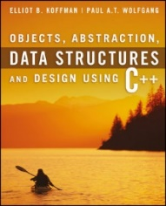
Welcome to
CS 235 Data Structures
Trees (Huffman ) (29)
Chapter 8.6, pgs. 496-505

Slide 2
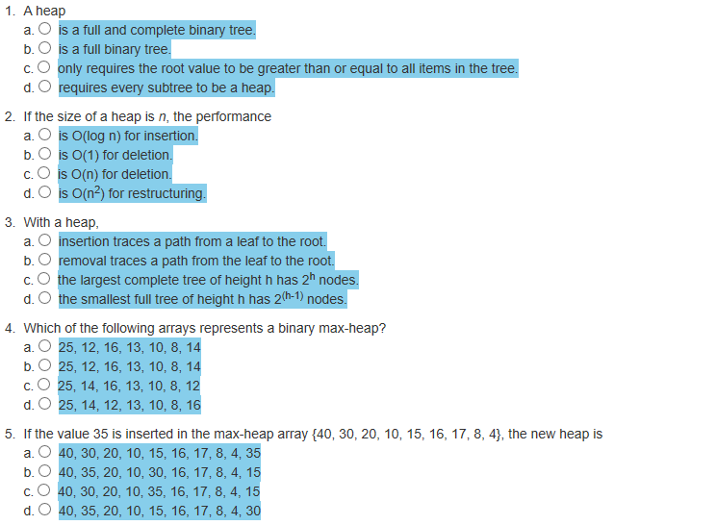
Attendance Quiz #28

Slide 3
Tip #29: Initialization Lists 2
One aspect of C++ that isn't fickle is the order in which an object's data is initialized.
The order is always the same:
Base classes are initialized before derived classes.
Within a class, data members are initialized in the order in which the are declared.
To avoid reader confusion, as well as the possibility of some truly obscure behavioral bugs, always list members in the initialization list in the same order as they're declared in the class.
class MyClass
{
private:
string name;
string address;
public:
MyClass(const string& n,
const string& a)
: address(a), name(n) { }
};
class MyClass
{
private:
string name;
string address;
public:
MyClass(const string& n,
const string& a)
: name(n), address(a) { }
};
×

Slide 4
Copying Objects
Applications require that a copy of an object be an independent copy, which means being able to modify one of the objects without affecting the other.
Copying of primitive types is straightforward—the values are duplicated and placed in the target locations (shallow).
If the object references a dynamically allocated object, the memory allocated to that object must be freed (deep).
The Gang of Three Rule basically states that if a class defines one (or more) of the following, it should probably explicitly define all three:
Copy constructor – create new object members from corresponding member constructors.
Copy assignment operator – assign corresponding members from existing members.
Destructor – call the destructors of all the object's class-type members.
The default constructors and assignment operators only do shallow copies.
Destructors contain code that is run whenever an object is destroyed.
An explicit deep copy constructor, assignment operator, and destructor must be created when a class contains pointers to dynamically allocated resources.

Slide 5
Copy Constructor / Assignment Operator
To create an independent copy of an object, the
Copy constructor is called when a new object is created from an existing object:
MyClass t1; // default constructor
MyClass t2 = t1; // copy constructor (t2 is new)
Assignment operator is called when an already initialized object is assigned a new value from another existing object.
t2 = t1; // assignment operator (t2 exists)
t2.operator=(t1); // assignment operator (equivalent)
Examples:
BST<int> bst1; // default constructor of bst1
BST<int> bst2(bst1); // copy constructor of bst1
bst2 = bst1; // assignment operator
The copy constructor is invoked automatically:
when an object is passed to a function by value.
when an object is returned from a function.
when an object is initialized with another object of the same class.
when the compiler generates a temporary object.

Slide 6
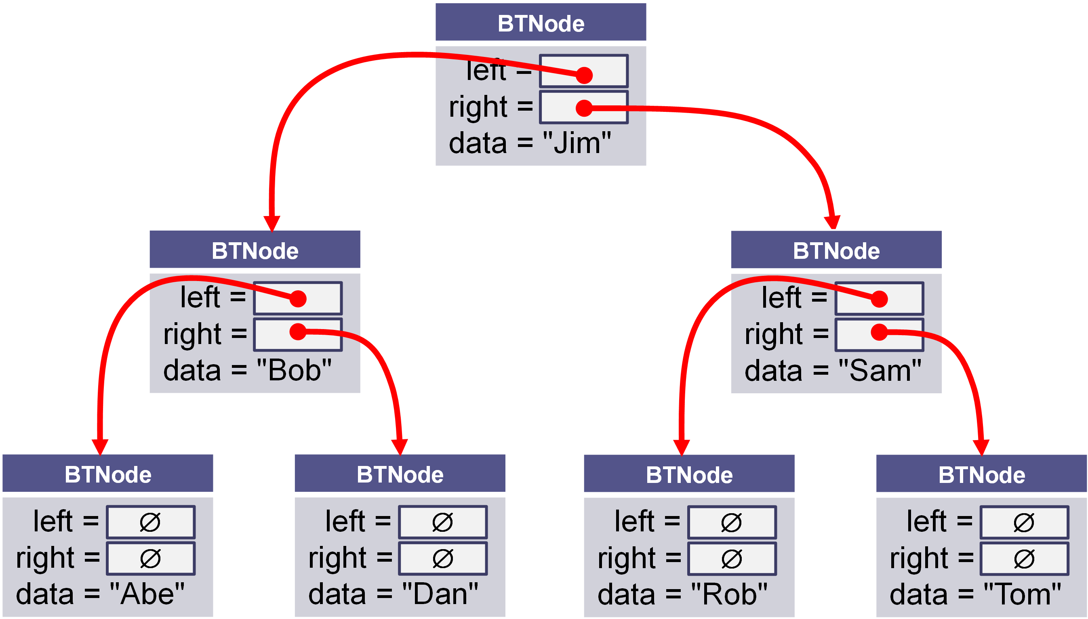
Shallow vs Deep Copy
Copying size and root fields create independent copies of the variables but not independent copies of the BST tree nodes.
Copying a pointer this way is considered a shallow copy.
We need to create an independent copy or a deep copy of the underlying array so that bst1.root and bst2.root point to different trees, making bst2 a deep copy of bst1.
BST<int> bst1
size_ = 7 int* root_ =
BST<int> bst2
size_ = 7 int* root_ =

Slide 7
Copy Constructor
/** Deep copy constructor.
@param bst The BST to be copied
@return This BST with a new copy of the bst's contents
*/
BST<T>(const BST<T>& bst) : root_(NULL), size_(0)
{
// recursively copy nodes from bst to this bst.
copyNode(bst.root_);
}
BST<int> bst1;
BST<int> bst2(bst1);
this
bst
Construct a new BST<T> (*this).
Recursively copy nodes from bst to the new BST.

Slide 8
Assignment Operator
/** Assign the contents of one BST to another.
@param other The BST to be assigned to this BST
@return This BST with a copy of the other BST's contents
*/
BST<T>& operator=(const BST<T>& rhs)
{
// Make a copy of the rhs BST.
BST<T> the_copy(rhs);
// Swap this' root with the_copy root.
swap(this->root, the_copy.root);
// Return self (the copy will be deleted)
return *this;
}
BST<int> bst1;
BST<int> bst2(bst1);
bst2 = bst1;
this
other
Make a deep copy of rhs (rhs → the_copy)
Exchange *this and the_copy elements only (*this ←→ the_copy)
Return *this and
Delete the_copy (destructor)

Slide 9
The Destructor
The purpose of the destructor is to undo what the constructor does.
The constructor takes a block of uninitialized memory and sets it to a valid state, thus creating an object.
When the destructor is finished, the object is in an invalid state and the memory it occupies can be reused for creating other objects.
If this is not done, the program will have memory leaks.
Each class has a default destructor, which effectively invokes the destructor for each data field.
If the pointer references a dynamically allocated object (such as the BST nodes referenced by pointer root), the memory allocated to that object must be freed!

Slide 10
Implementing a Min-Heap
Because a heap is a complete binary tree, it can be implemented efficiently using an array rather than a linked data structure.
For a node at position p with an array,
The left child's position is 2p + 1.
The right child's position is 2p + 2.
A node at position c in the array can find its parent at
floor((c – 1) / 2).
The root is found at index 0.
NOTE: most implementations use index 0 as the size of the heap and put the root at index 1 – the book does not.
The array representation is a level order traversal of the binary tree.

Slide 11
Implementing a Min-Heap
8
8
29
18
29
18
28
28
39
39
66
20
66
20
37
37
26
26
76
76
32
32
74
74
89
89
0 | 1 | 2 | 3 | 4 | 5 | 6 | 7 | 8 | 9 | 10 | 11 | 12 | 13
8 | 18 | 29 | 20 | 28 | 39 | 66 | 37 | 26 | 76 | 32 | 74 | 89

Slide 12
Implementing a Min-Heap
For a node at position p, L. child position: 2p + 1
R. child position: 2p + 2
8
18
29
20
28
39
66
37
26
76
32
74
89
0 | 1 | 2 | 3 | 4 | 5 | 6 | 7 | 8 | 9 | 10 | 11 | 12 | 13
8 | 18 | 29 | 20 | 28 | 39 | 66 | 37 | 26 | 76 | 32 | 74 | 89
Parent
L. Child
R. Child

Slide 13
Implementing a Min-Heap
For a node at position p, L. child position: 2p + 1
R. child position: 2p + 2
8
18
29
20
28
39
66
37
26
76
32
74
89
0 | 1 | 2 | 3 | 4 | 5 | 6 | 7 | 8 | 9 | 10 | 11 | 12 | 13
8 | 18 | 29 | 20 | 28 | 39 | 66 | 37 | 26 | 76 | 32 | 74 | 89
Parent
L. Child
R. Child

Slide 14
Implementing a Min-Heap
For a node at position p, L. child position: 2p + 1
R. child position: 2p + 2
8
18
29
20
28
39
66
37
26
76
32
74
89
0 | 1 | 2 | 3 | 4 | 5 | 6 | 7 | 8 | 9 | 10 | 11 | 12 | 13
8 | 18 | 29 | 20 | 28 | 39 | 66 | 37 | 26 | 76 | 32 | 74 | 89
Parent
L. Child
R. Child

Slide 15
Implementing a Min-Heap
For a node at position p, L. child position: 2p + 1
R. child position: 2p + 2
8
18
29
20
28
39
66
37
26
76
32
74
89
0 | 1 | 2 | 3 | 4 | 5 | 6 | 7 | 8 | 9 | 10 | 11 | 12 | 13
8 | 18 | 29 | 20 | 28 | 39 | 66 | 37 | 26 | 76 | 32 | 74 | 89
Parent
L. Child
R. Child

Slide 16
Implementing a Min-Heap
For a node at position p, L. child position: 2p + 1
R. child position: 2p + 2
8
18
29
20
28
39
66
37
26
76
32
74
89
0 | 1 | 2 | 3 | 4 | 5 | 6 | 7 | 8 | 9 | 10 | 11 | 12 | 13
8 | 18 | 29 | 20 | 28 | 39 | 66 | 37 | 26 | 76 | 32 | 74 | 89
Parent
L. Child
R. Child

Slide 17
Implementing a Min-Heap
For a node at position p, L. child position: 2p + 1
R. child position: 2p + 2
8
18
29
20
28
39
66
37
26
76
32
74
89
0 | 1 | 2 | 3 | 4 | 5 | 6 | 7 | 8 | 9 | 10 | 11 | 12 | 13
8 | 18 | 29 | 20 | 28 | 39 | 66 | 37 | 26 | 76 | 32 | 74 | 89
Parent
L. Child
R. Child

Slide 18
Implementing a Min-Heap
8
18
29
A node at position c can find its parent at (c – 1) / 2
20
28
39
66
37
26
76
32
74
89
0 | 1 | 2 | 3 | 4 | 5 | 6 | 7 | 8 | 9 | 10 | 11 | 12 | 13
8 | 18 | 29 | 20 | 28 | 39 | 66 | 37 | 26 | 76 | 32 | 74 | 89
Parent
Child

Slide 19
Inserting into a Vector Min-Heap
Insert the new element at the end of the vector.
Set child = vector.size() – 1.
Set parent = (child – 1) / 2.
while (parent >= 0 AND table[parent] > table[child])
Swap table[parent] and table[child].
Set child = parent.
Set parent = (child - 1) / 2.
8
18
29
20
28
39
66
37
26
76
32
74
89
0 | 1 | 2 | 3 | 4 | 5 | 6 | 7 | 8 | 9 | 10 | 11 | 12 | 13
8 | 18 | 29 | 20 | 28 | 39 | 66 | 37 | 26 | 76 | 32 | 74 | 89

Slide 20
Inserting into a Vector Min-Heap
Insert the new element at the end of the vector.
Set child = vector.size() – 1.
Set parent = (child – 1) / 2.
while (parent >= 0 AND table[parent] > table[child])
Swap table[parent] and table[child].
Set child = parent.
Set parent = (child - 1) / 2.
8
18
29
20
28
39
66
37
26
76
32
74
89
10
0 | 1 | 2 | 3 | 4 | 5 | 6 | 7 | 8 | 9 | 10 | 11 | 12 | 13
8 | 18 | 29 | 20 | 28 | 39 | 66 | 37 | 26 | 76 | 32 | 74 | 89 | 10

Slide 21
Inserting into a Vector Min-Heap
Insert the new element at the end of the vector.
Set child = vector.size() – 1.
Set parent = (child – 1) / 2.
while (parent >= 0 AND table[parent] > table[child])
Swap table[parent] and table[child].
Set child = parent.
Set parent = (child - 1) / 2.
8
18
29
20
28
39
66
37
26
76
32
74
89
10
0 | 1 | 2 | 3 | 4 | 5 | 6 | 7 | 8 | 9 | 10 | 11 | 12 | 13
8 | 18 | 29 | 20 | 28 | 39 | 66 | 37 | 26 | 76 | 32 | 74 | 89 | 10
Child

Slide 22
Inserting into a Vector Min-Heap
Insert the new element at the end of the vector.
Set child = vector.size() – 1.
Set parent = (child – 1) / 2.
while (parent >= 0 AND table[parent] > table[child])
Swap table[parent] and table[child].
Set child = parent.
Set parent = (child - 1) / 2.
8
18
29
20
28
39
66
37
26
76
32
74
89
10
0 | 1 | 2 | 3 | 4 | 5 | 6 | 7 | 8 | 9 | 10 | 11 | 12 | 13
8 | 18 | 29 | 20 | 28 | 39 | 66 | 37 | 26 | 76 | 32 | 74 | 89 | 10
Parent
Child

Slide 23
Inserting into a Vector Min-Heap
Insert the new element at the end of the vector.
Set child = vector.size() – 1.
Set parent = (child – 1) / 2.
while (parent >= 0 AND table[parent] > table[child])
Swap table[parent] and table[child].
Set child = parent.
Set parent = (child - 1) / 2.
8
18
29
20
28
39
66
37
26
76
32
74
89
10
0 | 1 | 2 | 3 | 4 | 5 | 6 | 7 | 8 | 9 | 10 | 11 | 12 | 13
8 | 18 | 29 | 20 | 28 | 39 | 66 | 37 | 26 | 76 | 32 | 74 | 89 | 10
Parent
Child

Slide 24
Inserting into a Vector Min-Heap
Insert the new element at the end of the vector.
Set child = vector.size() – 1.
Set parent = (child – 1) / 2.
while (parent >= 0 AND table[parent] > table[child])
Swap table[parent] and table[child].
Set child = parent.
Set parent = (child - 1) / 2.
8
18
29
20
28
39
10
37
26
76
32
74
89
66
0 | 1 | 2 | 3 | 4 | 5 | 6 | 7 | 8 | 9 | 10 | 11 | 12 | 13
8 | 18 | 29 | 20 | 28 | 39 | 10 | 37 | 26 | 76 | 32 | 74 | 89 | 66
Parent
Child

Slide 25
Inserting into a Vector Min-Heap
Insert the new element at the end of the vector.
Set child = vector.size() – 1.
Set parent = (child – 1) / 2.
while (parent >= 0 AND table[parent] > table[child])
Swap table[parent] and table[child].
Set child = parent.
Set parent = (child - 1) / 2.
8
18
29
20
28
39
10
37
26
76
32
74
89
66
0 | 1 | 2 | 3 | 4 | 5 | 6 | 7 | 8 | 9 | 10 | 11 | 12 | 13
8 | 18 | 29 | 20 | 28 | 39 | 10 | 37 | 26 | 76 | 32 | 74 | 89 | 66
Parent
Child

Slide 26
Inserting into a Vector Min-Heap
Insert the new element at the end of the vector.
Set child = vector.size() – 1.
Set parent = (child – 1) / 2.
while (parent >= 0 AND table[parent] > table[child])
Swap table[parent] and table[child].
Set child = parent.
Set parent = (child - 1) / 2.
8
18
29
20
28
39
10
37
26
76
32
74
89
66
0 | 1 | 2 | 3 | 4 | 5 | 6 | 7 | 8 | 9 | 10 | 11 | 12 | 13
8 | 18 | 29 | 20 | 28 | 39 | 10 | 37 | 26 | 76 | 32 | 74 | 89 | 66
Parent
Child

Slide 27
Inserting into a Vector Min-Heap
Insert the new element at the end of the vector.
Set child = vector.size() – 1.
Set parent = (child – 1) / 2.
while (parent >= 0 AND table[parent] > table[child])
Swap table[parent] and table[child].
Set child = parent.
Set parent = (child - 1) / 2.
8
18
29
20
28
39
10
37
26
76
32
74
89
66
0 | 1 | 2 | 3 | 4 | 5 | 6 | 7 | 8 | 9 | 10 | 11 | 12 | 13
8 | 18 | 29 | 20 | 28 | 39 | 10 | 37 | 26 | 76 | 32 | 74 | 89 | 66
Parent
Child

Slide 28
Inserting into a Vector Min-Heap
Insert the new element at the end of the vector.
Set child = vector.size() – 1.
Set parent = (child – 1) / 2.
while (parent >= 0 AND table[parent] > table[child])
Swap table[parent] and table[child].
Set child = parent.
Set parent = (child - 1) / 2.
8
18
10
20
28
39
29
37
26
76
32
74
89
66
0 | 1 | 2 | 3 | 4 | 5 | 6 | 7 | 8 | 9 | 10 | 11 | 12 | 13
8 | 18 | 10 | 20 | 28 | 39 | 29 | 37 | 26 | 76 | 32 | 74 | 89 | 66
Parent
Child

Slide 29
Inserting into a Vector Min-Heap
Insert the new element at the end of the vector.
Set child = vector.size() – 1.
Set parent = (child – 1) / 2.
while (parent >= 0 AND table[parent] > table[child])
Swap table[parent] and table[child].
Set child = parent.
Set parent = (child - 1) / 2.
8
18
10
20
28
39
29
37
26
76
32
74
89
66
0 | 1 | 2 | 3 | 4 | 5 | 6 | 7 | 8 | 9 | 10 | 11 | 12 | 13
8 | 18 | 10 | 20 | 28 | 39 | 29 | 37 | 26 | 76 | 32 | 74 | 89 | 66
Parent
Child

Slide 30
Inserting into a Vector Min-Heap
Insert the new element at the end of the vector.
Set child = vector.size() – 1.
Set parent = (child – 1) / 2.
while (parent >= 0 AND table[parent] > table[child])
Swap table[parent] and table[child].
Set child = parent.
Set parent = (child - 1) / 2.
8
18
10
20
28
39
29
37
26
76
32
74
89
66
0 | 1 | 2 | 3 | 4 | 5 | 6 | 7 | 8 | 9 | 10 | 11 | 12 | 13
8 | 18 | 10 | 20 | 28 | 39 | 29 | 37 | 26 | 76 | 32 | 74 | 89 | 66
Parent
Child

Slide 31
Inserting into a Vector Min-Heap
Insert the new element at the end of the vector.
Set child = vector.size() – 1.
Set parent = (child – 1) / 2.
while (parent >= 0 AND table[parent] > table[child])
Swap table[parent] and table[child].
Set child = parent.
Set parent = (child - 1) / 2.
8
18
10
20
28
39
29
37
26
76
32
74
89
66
0 | 1 | 2 | 3 | 4 | 5 | 6 | 7 | 8 | 9 | 10 | 11 | 12 | 13
8 | 18 | 10 | 20 | 28 | 39 | 29 | 37 | 26 | 76 | 32 | 74 | 89 | 66
Parent
Child

Slide 32
Inserting into a Vector Min-Heap
Insert the new element at the end of the vector.
Set child = vector.size() – 1.
Set parent = (child – 1) / 2.
while (parent >= 0 AND table[parent] > table[child])
Swap table[parent] and table[child].
Set child = parent.
Set parent = (child - 1) / 2.
8
18
10
20
28
39
29
37
26
76
32
74
89
66
0 | 1 | 2 | 3 | 4 | 5 | 6 | 7 | 8 | 9 | 10 | 11 | 12 | 13
8 | 18 | 10 | 20 | 28 | 39 | 29 | 37 | 26 | 76 | 32 | 74 | 89 | 66

Slide 33
Removal from a Vector Min-Heap
Save table[0].
Set table[0] to table[--size].
Set parent to 0.
while (true)
Set leftChild to (2 × parent) + 1
and rightChild to leftChild + 1.
if leftChild >= table.size() break.
Set minChild to leftChild.
if rightChild < table.size() and
table[leftChild] > table[rightChild]
Set minChild to rightChild.
if table[parent] <= table[minChild] break.
Swap table[parent] and table[minChild].
Set parent to minChild.
Return saved value.

Slide 34
Removal from a Vector Min-Heap
Save table[0].
Set table[0] to table[--size].
Set parent to 0.
while (true)
Set leftChild to (2 × parent) + 1
and rightChild to leftChild + 1.
if leftChild >= table.size() break.
Set minChild to leftChild.
if rightChild < table.size() and
table[leftChild] > table[rightChild]
Set minChild to rightChild.
if table[parent] <= table[minChild] break.
Swap table[parent] and table[minChild].
Set parent to minChild.
Return saved value.
8
18
10
20
28
39
29
37
26
76
32
74
89
66
0 | 1 | 2 | 3 | 4 | 5 | 6 | 7 | 8 | 9 | 10 | 11 | 12 | 13
8 | 18 | 10 | 20 | 28 | 39 | 29 | 37 | 26 | 76 | 32 | 74 | 89 | 66

Slide 35
Removal from a Vector Min-Heap
Save table[0].
Set table[0] to table[--size].
Set parent to 0.
while (true)
Set leftChild to (2 × parent) + 1
and rightChild to leftChild + 1.
if leftChild >= table.size() break.
Set minChild to leftChild.
if rightChild < table.size() and
table[leftChild] > table[rightChild]
Set minChild to rightChild.
if table[parent] <= table[minChild] break.
Swap table[parent] and table[minChild].
Set parent to minChild.
Return saved value.
8
8
18
10
20
28
39
29
37
26
76
32
74
89
66
0 | 1 | 2 | 3 | 4 | 5 | 6 | 7 | 8 | 9 | 10 | 11 | 12 | 13
8 | 18 | 10 | 20 | 28 | 39 | 29 | 37 | 26 | 76 | 32 | 74 | 89 | 66

Slide 36
Removal from a Vector Min-Heap
Save table[0].
Set table[0] to table[--size].
Set parent to 0.
while (true)
Set leftChild to (2 × parent) + 1
and rightChild to leftChild + 1.
if leftChild >= table.size() break.
Set minChild to leftChild.
if rightChild < table.size() and
table[leftChild] > table[rightChild]
Set minChild to rightChild.
if table[parent] <= table[minChild] break.
Swap table[parent] and table[minChild].
Set parent to minChild.
Return saved value.
8
66
18
10
20
28
39
29
37
26
76
32
74
89
0 | 1 | 2 | 3 | 4 | 5 | 6 | 7 | 8 | 9 | 10 | 11 | 12 | 13
66 | 18 | 10 | 20 | 28 | 39 | 29 | 37 | 26 | 76 | 32 | 74 | 89 | 66

Slide 37
Removal from a Vector Min-Heap
Save table[0].
Set table[0] to table[--size].
Set parent to 0.
while (true)
Set leftChild to (2 × parent) + 1
and rightChild to leftChild + 1.
if leftChild >= table.size() break.
Set minChild to leftChild.
if rightChild < table.size() and
table[leftChild] > table[rightChild]
Set minChild to rightChild.
if table[parent] <= table[minChild] break.
Swap table[parent] and table[minChild].
Set parent to minChild.
Return saved value.
8
66
18
10
20
28
39
29
37
26
76
32
74
89
0 | 1 | 2 | 3 | 4 | 5 | 6 | 7 | 8 | 9 | 10 | 11 | 12 | 13
66 | 18 | 10 | 20 | 28 | 39 | 29 | 37 | 26 | 76 | 32 | 74 | 89
Parent

Slide 38
Removal from a Vector Min-Heap
Save table[0].
Set table[0] to table[--size].
Set parent to 0.
while (true)
Set leftChild to (2 × parent) + 1
and rightChild to leftChild + 1.
if leftChild >= table.size() break.
Set minChild to leftChild.
if rightChild < table.size() and
table[leftChild] > table[rightChild]
Set minChild to rightChild.
if table[parent] <= table[minChild] break.
Swap table[parent] and table[minChild].
Set parent to minChild.
Return saved value.
8
66
18
10
20
28
39
29
37
26
76
32
74
89
0 | 1 | 2 | 3 | 4 | 5 | 6 | 7 | 8 | 9 | 10 | 11 | 12 | 13
66 | 18 | 10 | 20 | 28 | 39 | 29 | 37 | 26 | 76 | 32 | 74 | 89
Parent
Left
Right

Slide 39
Removal from a Vector Min-Heap
Save table[0].
Set table[0] to table[--size].
Set parent to 0.
while (true)
Set leftChild to (2 × parent) + 1
and rightChild to leftChild + 1.
if leftChild >= table.size() break.
Set minChild to leftChild.
if rightChild < table.size() and
table[leftChild] > table[rightChild]
Set minChild to rightChild.
if table[parent] <= table[minChild] break.
Swap table[parent] and table[minChild].
Set parent to minChild.
Return saved value.
8
66
18
10
20
28
39
29
37
26
76
32
74
89
0 | 1 | 2 | 3 | 4 | 5 | 6 | 7 | 8 | 9 | 10 | 11 | 12 | 13
66 | 18 | 10 | 20 | 28 | 39 | 29 | 37 | 26 | 76 | 32 | 74 | 89
Parent
Min
Right

Slide 40
Removal from a Vector Min-Heap
Save table[0].
Set table[0] to table[--size].
Set parent to 0.
while (true)
Set leftChild to (2 × parent) + 1
and rightChild to leftChild + 1.
if leftChild >= table.size() break.
Set minChild to leftChild.
if rightChild < table.size() and
table[leftChild] > table[rightChild]
Set minChild to rightChild.
if table[parent] <= table[minChild] break.
Swap table[parent] and table[minChild].
Set parent to minChild.
Return saved value.
8
66
18
10
20
28
39
29
37
26
76
32
74
89
0 | 1 | 2 | 3 | 4 | 5 | 6 | 7 | 8 | 9 | 10 | 11 | 12 | 13
66 | 18 | 10 | 20 | 28 | 39 | 29 | 37 | 26 | 76 | 32 | 74 | 89
Parent
Min

Slide 41
Removal from a Vector Min-Heap
Save table[0].
Set table[0] to table[--size].
Set parent to 0.
while (true)
Set leftChild to (2 × parent) + 1
and rightChild to leftChild + 1.
if leftChild >= table.size() break.
Set minChild to leftChild.
if rightChild < table.size() and
table[leftChild] > table[rightChild]
Set minChild to rightChild.
if table[parent] <= table[minChild] break.
Swap table[parent] and table[minChild].
Set parent to minChild.
Return saved value.
8
66
18
10
20
28
39
29
37
26
76
32
74
89
0 | 1 | 2 | 3 | 4 | 5 | 6 | 7 | 8 | 9 | 10 | 11 | 12 | 13
66 | 18 | 10 | 20 | 28 | 39 | 29 | 37 | 26 | 76 | 32 | 74 | 89
Parent
Min

Slide 42
Removal from a Vector Min-Heap
Save table[0].
Set table[0] to table[--size].
Set parent to 0.
while (true)
Set leftChild to (2 × parent) + 1
and rightChild to leftChild + 1.
if leftChild >= table.size() break.
Set minChild to leftChild.
if rightChild < table.size() and
table[leftChild] > table[rightChild]
Set minChild to rightChild.
if table[parent] <= table[minChild] break.
Swap table[parent] and table[minChild].
Set parent to minChild.
Return saved value.
8
10
18
66
20
28
39
29
37
26
76
32
74
89
0 | 1 | 2 | 3 | 4 | 5 | 6 | 7 | 8 | 9 | 10 | 11 | 12 | 13
10 | 18 | 66 | 20 | 28 | 39 | 29 | 37 | 26 | 76 | 32 | 74 | 89
Parent
Min

Slide 43
Removal from a Vector Min-Heap
Save table[0].
Set table[0] to table[--size].
Set parent to 0.
while (true)
Set leftChild to (2 × parent) + 1
and rightChild to leftChild + 1.
if leftChild >= table.size() break.
Set minChild to leftChild.
if rightChild < table.size() and
table[leftChild] > table[rightChild]
Set minChild to rightChild.
if table[parent] <= table[minChild] break.
Swap table[parent] and table[minChild].
Set parent to minChild.
Return saved value.
8
10
18
66
20
28
39
29
37
26
76
32
74
89
0 | 1 | 2 | 3 | 4 | 5 | 6 | 7 | 8 | 9 | 10 | 11 | 12 | 13
10 | 18 | 66 | 20 | 28 | 39 | 29 | 37 | 26 | 76 | 32 | 74 | 89
Parent

Slide 44
Removal from a Vector Min-Heap
Save table[0].
Set table[0] to table[--size].
Set parent to 0.
while (true)
Set leftChild to (2 × parent) + 1
and rightChild to leftChild + 1.
if leftChild >= table.size() break.
Set minChild to leftChild.
if rightChild < table.size() and
table[leftChild] > table[rightChild]
Set minChild to rightChild.
if table[parent] <= table[minChild] break.
Swap table[parent] and table[minChild].
Set parent to minChild.
Return saved value.
8
10
18
66
20
28
39
29
37
26
76
32
74
89
0 | 1 | 2 | 3 | 4 | 5 | 6 | 7 | 8 | 9 | 10 | 11 | 12 | 13
10 | 18 | 66 | 20 | 28 | 39 | 29 | 37 | 26 | 76 | 32 | 74 | 89
Parent
Left
Right

Slide 45
Removal from a Vector Min-Heap
Save table[0].
Set table[0] to table[--size].
Set parent to 0.
while (true)
Set leftChild to (2 × parent) + 1
and rightChild to leftChild + 1.
if leftChild >= table.size() break.
Set minChild to leftChild.
if rightChild < table.size() and
table[leftChild] > table[rightChild]
Set minChild to rightChild.
if table[parent] <= table[minChild] break.
Swap table[parent] and table[minChild].
Set parent to minChild.
Return saved value.
8
10
18
66
20
28
39
29
37
26
76
32
74
89
0 | 1 | 2 | 3 | 4 | 5 | 6 | 7 | 8 | 9 | 10 | 11 | 12 | 13
10 | 18 | 66 | 20 | 28 | 39 | 29 | 37 | 26 | 76 | 32 | 74 | 89
Parent
Min
Right

Slide 46
Removal from a Vector Min-Heap
Save table[0].
Set table[0] to table[--size].
Set parent to 0.
while (true)
Set leftChild to (2 × parent) + 1
and rightChild to leftChild + 1.
if leftChild >= table.size() break.
Set minChild to leftChild.
if rightChild < table.size() and
table[leftChild] > table[rightChild]
Set minChild to rightChild.
if table[parent] <= table[minChild] break.
Swap table[parent] and table[minChild].
Set parent to minChild.
Return saved value.
8
10
18
66
20
28
39
29
37
26
76
32
74
89
0 | 1 | 2 | 3 | 4 | 5 | 6 | 7 | 8 | 9 | 10 | 11 | 12 | 13
10 | 18 | 66 | 20 | 28 | 39 | 29 | 37 | 26 | 76 | 32 | 74 | 89
Parent
Min

Slide 47
Removal from a Vector Min-Heap
Save table[0].
Set table[0] to table[--size].
Set parent to 0.
while (true)
Set leftChild to (2 × parent) + 1
and rightChild to leftChild + 1.
if leftChild >= table.size() break.
Set minChild to leftChild.
if rightChild < table.size() and
table[leftChild] > table[rightChild]
Set minChild to rightChild.
if table[parent] <= table[minChild] break.
Swap table[parent] and table[minChild].
Set parent to minChild.
Return saved value.
8
10
18
66
20
28
39
29
37
26
76
32
74
89
0 | 1 | 2 | 3 | 4 | 5 | 6 | 7 | 8 | 9 | 10 | 11 | 12 | 13
10 | 18 | 66 | 20 | 28 | 39 | 29 | 37 | 26 | 76 | 32 | 74 | 89
Parent
Min

Slide 48
Removal from a Vector Min-Heap
Save table[0].
Set table[0] to table[--size].
Set parent to 0.
while (true)
Set leftChild to (2 × parent) + 1
and rightChild to leftChild + 1.
if leftChild >= table.size() break.
Set minChild to leftChild.
if rightChild < table.size() and
table[leftChild] > table[rightChild]
Set minChild to rightChild.
if table[parent] <= table[minChild] break.
Swap table[parent] and table[minChild].
Set parent to minChild.
Return saved value.
8
10
18
29
20
28
39
66
37
26
76
32
74
89
0 | 1 | 2 | 3 | 4 | 5 | 6 | 7 | 8 | 9 | 10 | 11 | 12 | 13
10 | 18 | 29 | 20 | 28 | 39 | 66 | 37 | 26 | 76 | 32 | 74 | 89
Parent
Min

Slide 49
Removal from a Vector Min-Heap
Save table[0].
Set table[0] to table[--size].
Set parent to 0.
while (true)
Set leftChild to (2 × parent) + 1
and rightChild to leftChild + 1.
if leftChild >= table.size() break.
Set minChild to leftChild.
if rightChild < table.size() and
table[leftChild] > table[rightChild]
Set minChild to rightChild.
if table[parent] <= table[minChild] break.
Swap table[parent] and table[minChild].
Set parent to minChild.
Return saved value.
8
10
18
29
20
28
39
66
37
26
76
32
74
89
0 | 1 | 2 | 3 | 4 | 5 | 6 | 7 | 8 | 9 | 10 | 11 | 12 | 13
10 | 18 | 29 | 20 | 28 | 39 | 66 | 37 | 26 | 76 | 32 | 74 | 89
Parent

Slide 50
Removal from a Vector Min-Heap
Save table[0].
Set table[0] to table[--size].
Set parent to 0.
while (true)
Set leftChild to (2 × parent) + 1
and rightChild to leftChild + 1.
if leftChild >= table.size() break.
Set minChild to leftChild.
if rightChild < table.size() and
table[leftChild] > table[rightChild]
Set minChild to rightChild.
if table[parent] <= table[minChild] break.
Swap table[parent] and table[minChild].
Set parent to minChild.
Return saved value.
8
10
18
29
20
28
39
66
37
26
76
32
74
89
0 | 1 | 2 | 3 | 4 | 5 | 6 | 7 | 8 | 9 | 10 | 11 | 12 | 13
10 | 18 | 29 | 20 | 28 | 39 | 66 | 37 | 26 | 76 | 32 | 74 | 89
Parent
Left
Right

Slide 51
Removal from a Vector Min-Heap
Save table[0].
Set table[0] to table[--size].
Set parent to 0.
while (true)
Set leftChild to (2 × parent) + 1
and rightChild to leftChild + 1.
if leftChild >= table.size() break.
Set minChild to leftChild.
if rightChild < table.size() and
table[leftChild] > table[rightChild]
Set minChild to rightChild.
if table[parent] <= table[minChild] break.
Swap table[parent] and table[minChild].
Set parent to minChild.
Return saved value.
8
10
18
29
20
28
39
66
37
26
76
32
74
89
0 | 1 | 2 | 3 | 4 | 5 | 6 | 7 | 8 | 9 | 10 | 11 | 12 | 13
10 | 18 | 29 | 20 | 28 | 39 | 66 | 37 | 26 | 76 | 32 | 74 | 89
Parent
Left
Right

Slide 52
Performance of the Heap
Removal / insertion algorithms
Removal traces a path from the root to a leaf.
Insertion traces a path from a leaf to the root.
Both require at most h steps where h is the height of the tree.
The largest full tree of height h has 2^{h}-1 nodes.
The smallest complete tree of height h has 2^{(h-1)} nodes.
Both insert and remove are O(log n) where n is the number of items in the heap.

Slide 53
Performance of the Heap
A priority queue is a queue that does not have the “first in, first out” logic.
Heaps offer an easy access to the largest (smallest) elements, by positioning values at the root.
Heaps are an implementation of priority queues.
Priority queues can be implemented by heaps, and heaps can be implemented by arrays.
Removal / insertion algorithms
Removal traces a path from the root to a leaf.
Insertion traces a path from a leaf to the root.
Both require at most h steps where h is the height of the tree.
The largest full tree of height h has 2^{h}-1 nodes.
The smallest complete tree of height h has 2^{(h-1)} nodes.
Both insert and remove are O(log n) where n is the number of items in the heap.

Slide 54
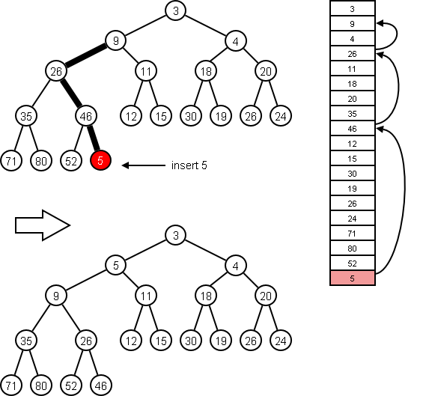
8.5 Heaps and Priority Queues
Priority Queues
The priority_queue Class
Using a Heap as the Basis of a Priority Queue
8.5, pgs. 484-495

Slide 55
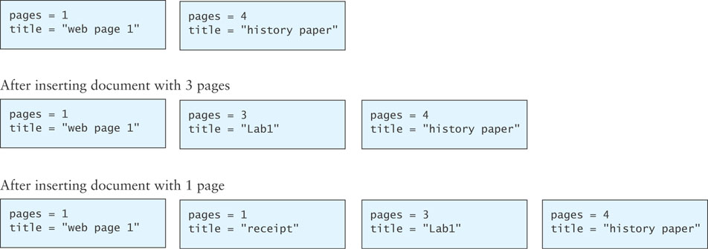
Priority Queues
The heap is used to implement a special kind of queue called a priority queue.
Sometimes a standard FIFO queue may not be the best way to implement a waiting line.
A priority queue is a data structure in which only the highest-priority item is accessible (as opposed to the first item entered).
For example, in a print queue, it might be more appropriate to print a short document that arrived after a very long document.

Slide 56
priority_queue Class
C++ provides a priority_queue class that uses the same interface as the queue given in Chapter 6.
The differences are in the specification for the top and pop functions—these are defined to return a largest item in the queue rather than an oldest item.

Slide 57
Heap Priority Queue
In a priority queue, just like a max-heap, the largest item always is removed first.
Because heap insertion and removal is O(log n), a heap can be the basis of a very efficient implementation of a priority queue.

Slide 58
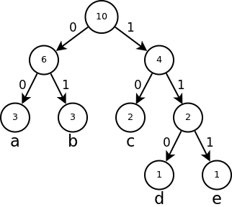
8.6 Huffman Trees
Case Study: Building a Custom Huffman Tree
8.6, pgs. 496-505

Slide 59
Huffman Trees
Huffman coding is a lossless data compression algorithm.
Assign variable-length codes to input characters based on the frequencies of corresponding characters.
The most frequent character gets the smallest code and the least frequent character gets the largest code.
A straight binary encoding of an alphabet assigns a unique 8-bit binary number to each symbol in the alphabet.
As ASCII has 256 possible characters, the length of a message would be 8 x n where n is the total number of character.
The message “go cougars” requires 10 x 8 or 80 bits in ASCII.
The same string encoded using a good Huffman encoding schema would only require 40 bits.
A Huffman tree can be implemented using a binary tree and a priority_queue (min-heap.)

Slide 60
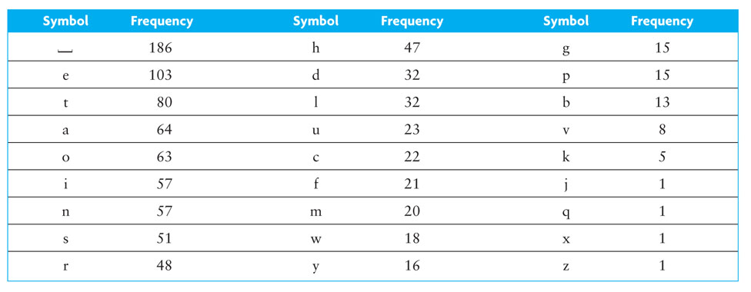
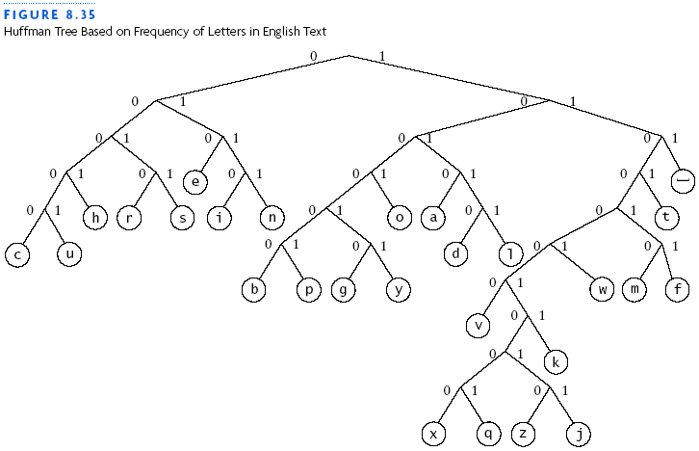
Huffman Trees
In 1973, Donald Knuth published the relative frequencies of the letters in English text.
The letter 'e' occurs an average of 103 times every 1000 letters (or 10.3% of the letters are e's.)
e = 010

Slide 61
1. What are the Huffman codes for the characters found in the Huffman binary tree to the right?
13
0
1
5
s
8
0
1
char | frequency | encoding
s | 5
e | 4
l | 2
n | 1
p | 1
4
e
4
0
1
2
l
2
0
1
1
n
1
p
2. Using the above Huffman codes, what word is represented with the following 27-bit stream?
011010101111110100011101000
3. What is the resulting compression ratio of Huffman encoding verses 8-bit ASCII encoding?

Slide 62
1. What are the Huffman codes for the characters found in the Huffman binary tree to the right?
13
0
1
5
s
8
0
1
char | frequency | encoding
s | 5
e | 4
l | 2
n | 1
p | 1
4
e
4
0
0
1
10
2
l
2
110
0
1
1110
1
n
1
p
1111
2. Using the above Huffman codes, what word is represented with the following 27-bit stream?
s
l
e
e
p
l
e
s
s
n
e
s
011010101111110100011101000
s
3. What is the resulting compression ratio of Huffman encoding verses 8-bit ASCII encoding?
(13 x 8 = 104 bits) : 27 bits or 4 : 1

Slide 63
Steps to build Huffman Tree
Input: array of unique characters with their frequency of occurrences.
Create a leaf node for each unique character and build a min-heap of all leaf nodes.
Min-heap is used as a priority queue.
The value of frequency field is used to compare two nodes in min-heap.
The least frequent character will be at root (min-heap).
Extract two nodes (minimum frequencies) from the min-heap and create a new internal node whose frequency is the sum of the two extracted node frequencies.
Make the first extracted node the left child and the second node the right child.
Add the new internal node (with two children) to the min-heap.
Repeat steps #2 and #3 until the heap contains only one node.
The tree is complete and the remaining node is the root node of a Huffman Binary Tree.

Slide 64
An assassin sins
char | frequency | encoding
a | 3
n | 3
sp | 2
i | 2
s | 6
16
encoding
00
01
100
101
11
0
1
1. Create a leaf node for each unique character and build a min-heap of all leaf nodes.
6
10
0
1
0
1
3
a
3
n
4
6
s
2 ␣ | 2 i | 3 a | 3 n | 6 s
0
1
2
2
i
␣
2. Extract two nodes, create new node w/frequency equal to the sum of the two node frequencies, and add back to min-heap. Repeat until 1 node.
0 | 1 | 2 | 3 | 4
2 ␣ | 2 i | 3 a | 3 n | 6 s
0 | 1 | 2 | 3
3 a | 3 n | 6 s | 4 $
0 | 1 | 2
4 $ | 6 s | 6 $
0 | 1
6 $ | 10 $
0
16 $
2 ␣ | 2 i
2 ␣ | 2 i
3 a | 3 n
3 a | 3 n
4 $ | 6 s
6 $ | 10 $
2 ␣ | 2 i
3 a | 3 n
4 $ | 6 s
3. What is the bit stream for "An assassin sins"?
2 ␣ | 2 i
00
01
100
00
11
11
00
11
11
101
01
100
11
101
01
11

Slide 65
aaabbc
char | frequency | encoding
a
b
c
1. Using the above character stream, create a leaf node for each unique character and build a min-heap of all leaf nodes.
3
2
1
0
11
10
0 | 1 | 2
1 c | 3 a | 2 b
2. Extract two nodes, create new node w/frequency equal to the sum of the two node frequencies, and add back to min-heap. Repeat until 1 node.
0 | 1 | 2
1 c | 3 a | 2 b
0 | 1
3 a | 3 $
0
6 $
6
0
1
3
a
3
1 c | 2 b
3 a | 3 $
0
1
1 c | 2 b
1
c
2
b
3. What is the bit stream for "baa"?
1100
4. What is the resulting compression ratio of Huffman to ASCII?
4:24

Slide 66
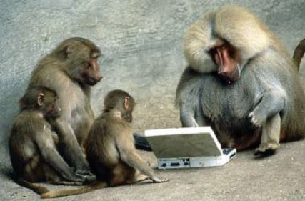
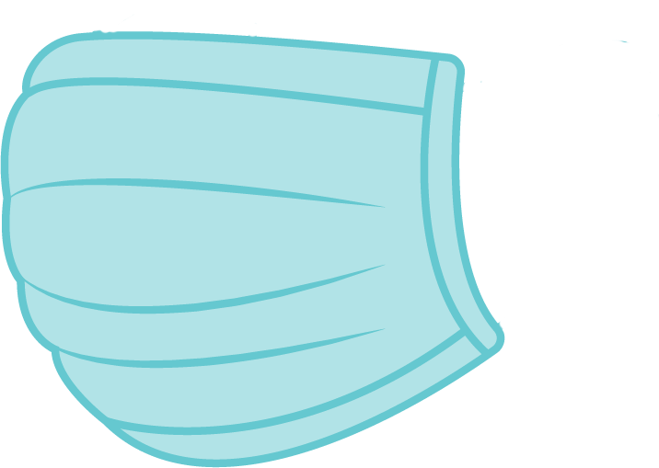
Be Safe

